Slide 1
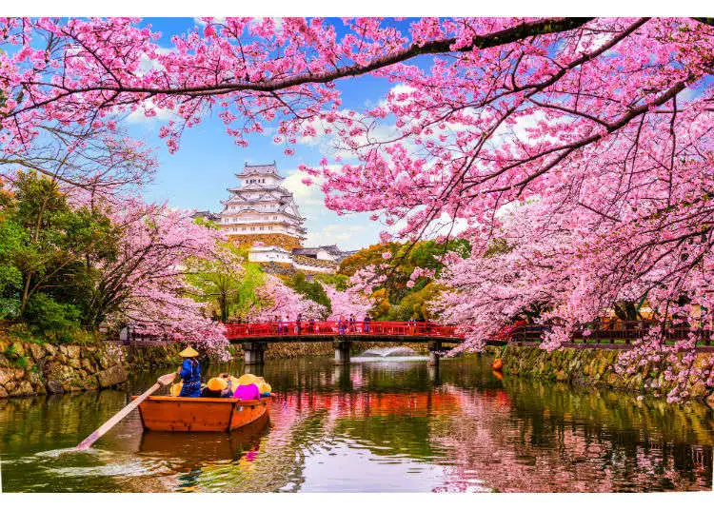
Seeing the Sakura Bloom
Alexandra Schoenberg
Springboard Data Science Career Track, 2022-23

Slide 2
The Problem
One of Japan’s most beautiful and popular attractions, for visitors and locals alike, is the blooming sakura flowers
These flowers bloom only for a short period of time in the spring, and correctly timing a trip to see them can be tricky
Can we use ambient temperature data to create a model that will accurately predict the “best” day to see the sakura flowers in peak bloom?

Slide 3
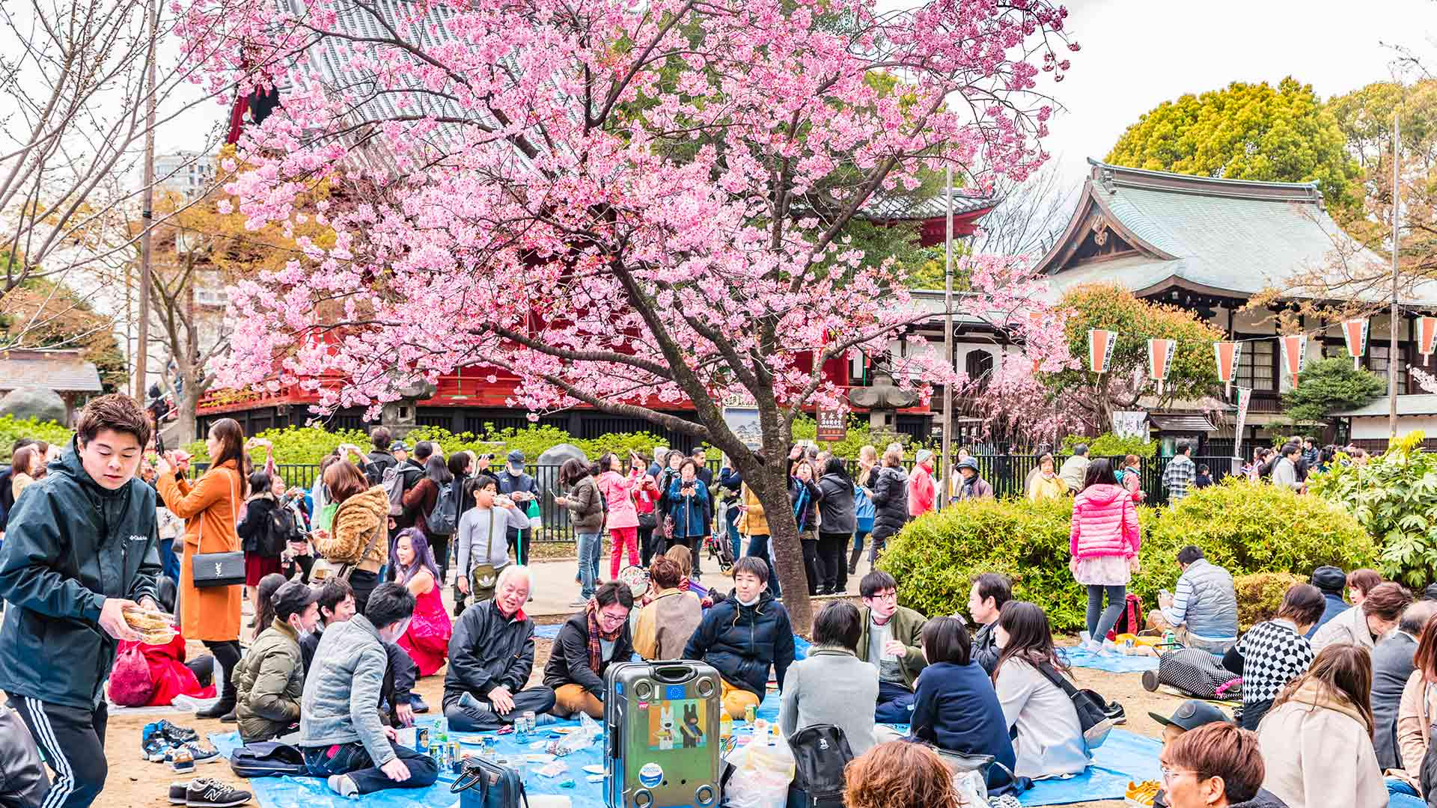

Who Might Care?
Travelers from far and wide
Local families enjoying a picnic
…and anyone with an appreciation for nature or Japanese culture!

Slide 4
What Factors Might Impact the Bloom?
Weather and nature are very complicated and intertwined
The annual bloom date could possibly be affected by:
Temperature
Rainfall
Sunshine
Air quality
Wind patterns
Natural disasters – Japan is subject to earthquakes, tsunamis, and even volcanic activity
Etc.

Slide 5
Data Information
Ambient temperature data, sourced from the Japanese Meteorological Agency
Sakura bloom status data, specific to Hirosaki Park in Hirosaki City, sourced from the Hirosaki City Green Association
Data acquired for the period of Jan 1, 1997 – Dec 31, 2019
Initial dataset contained 3 columns (date, temperature, bloom status) and 9131 rows
File format: csv
Each record: an individual day

Slide 6
Data Wrangling
Date values were split into 3 columns: day, month, year
Bloom status values were labeled and imputed
0: full bloom
1: bloom
2: scatter
3: no bloom
Historically non-blooming months were removed, leaving only April and May data
Result was a cleaned DataFrame of 5 columns and 1525 rows

Slide 7
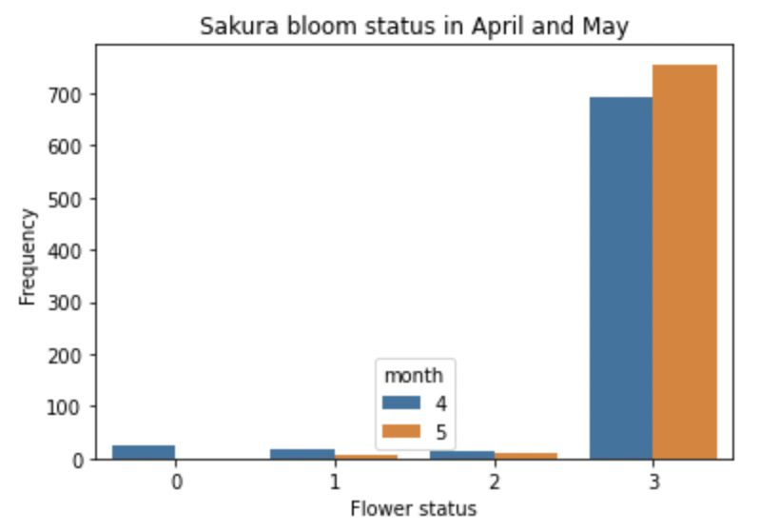
Data Exploration
The first figure indicates that, even in the blooming months, the
bloom period itself is quite short.

Slide 8
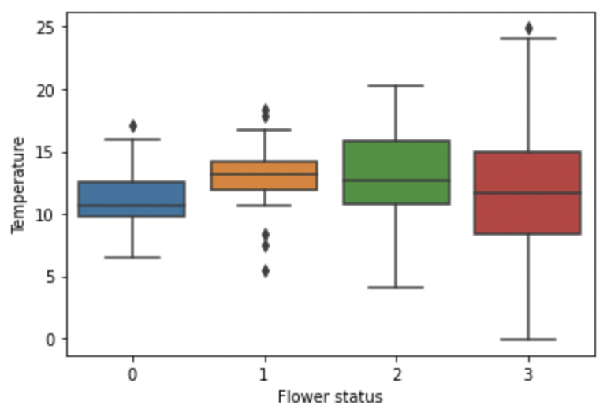
Relationship Visualization
The second figure, a box and whisker plot, provides a visualization
of the temperature ranges and medians with respect to blooming status,
within the months of April and May.
Notes:
Note that the medians are all similar – within the range of 10-13 degrees C. If we include the outliers (for status 1), it can be noted that the overall temperature range “tightens” for each step towards a full bloom.

Slide 9
Modeling
Decision Tree Classifier model with binary categories
All blooming statuses (full, bloom, scatter): 1
Non-blooming status: 0
Features were magnitude standardized
Each model output included a Principal Component Analysis scatterplot and a Classification Report, providing precision, recall, F1, and accuracy scores

Slide 10
Modeling
Because the data was extremely unbalanced, multiple models were created using different sampling methods:
imbalanced (baseline model)
oversampled
undersampled
oversampled with SMOTE technique
The most successful model was the oversampled model

Slide 11
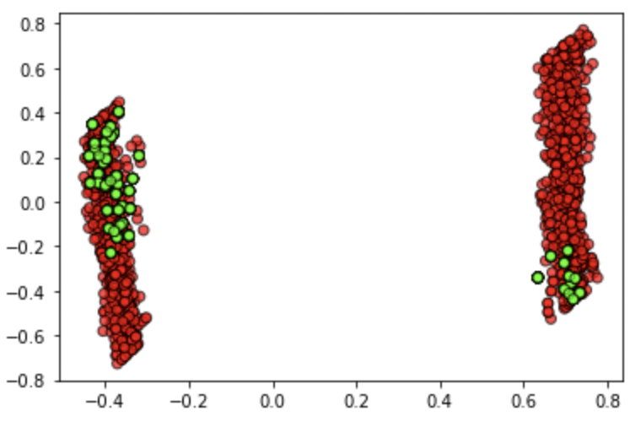
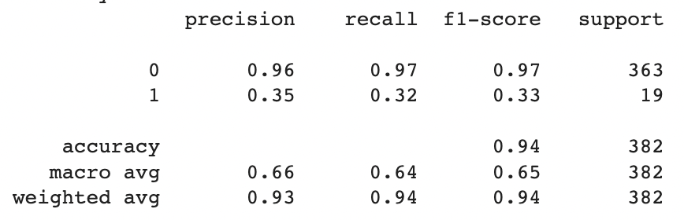
Model Results
Oversampled model PCA
Oversampled model Classification Report

Slide 12
Takeaways and Future Steps
This model demonstrated that the correlation between temperature and blooming was not very strong, and that many more features and factors are likely at play in determining the blossoming timeline
Although the model was not very successful, the project was a good lesson for me with regards to data collection and project design
In the future, I will build upon this foundation to select more comprehensive data and asking more discerning questions

